Slide 1
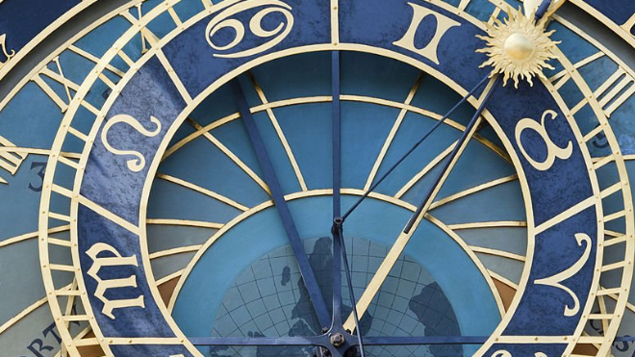
Cepher Distinguishment

Slide 2
__ Reasons to make
Cepher your scripture
of choice.

Slide 3
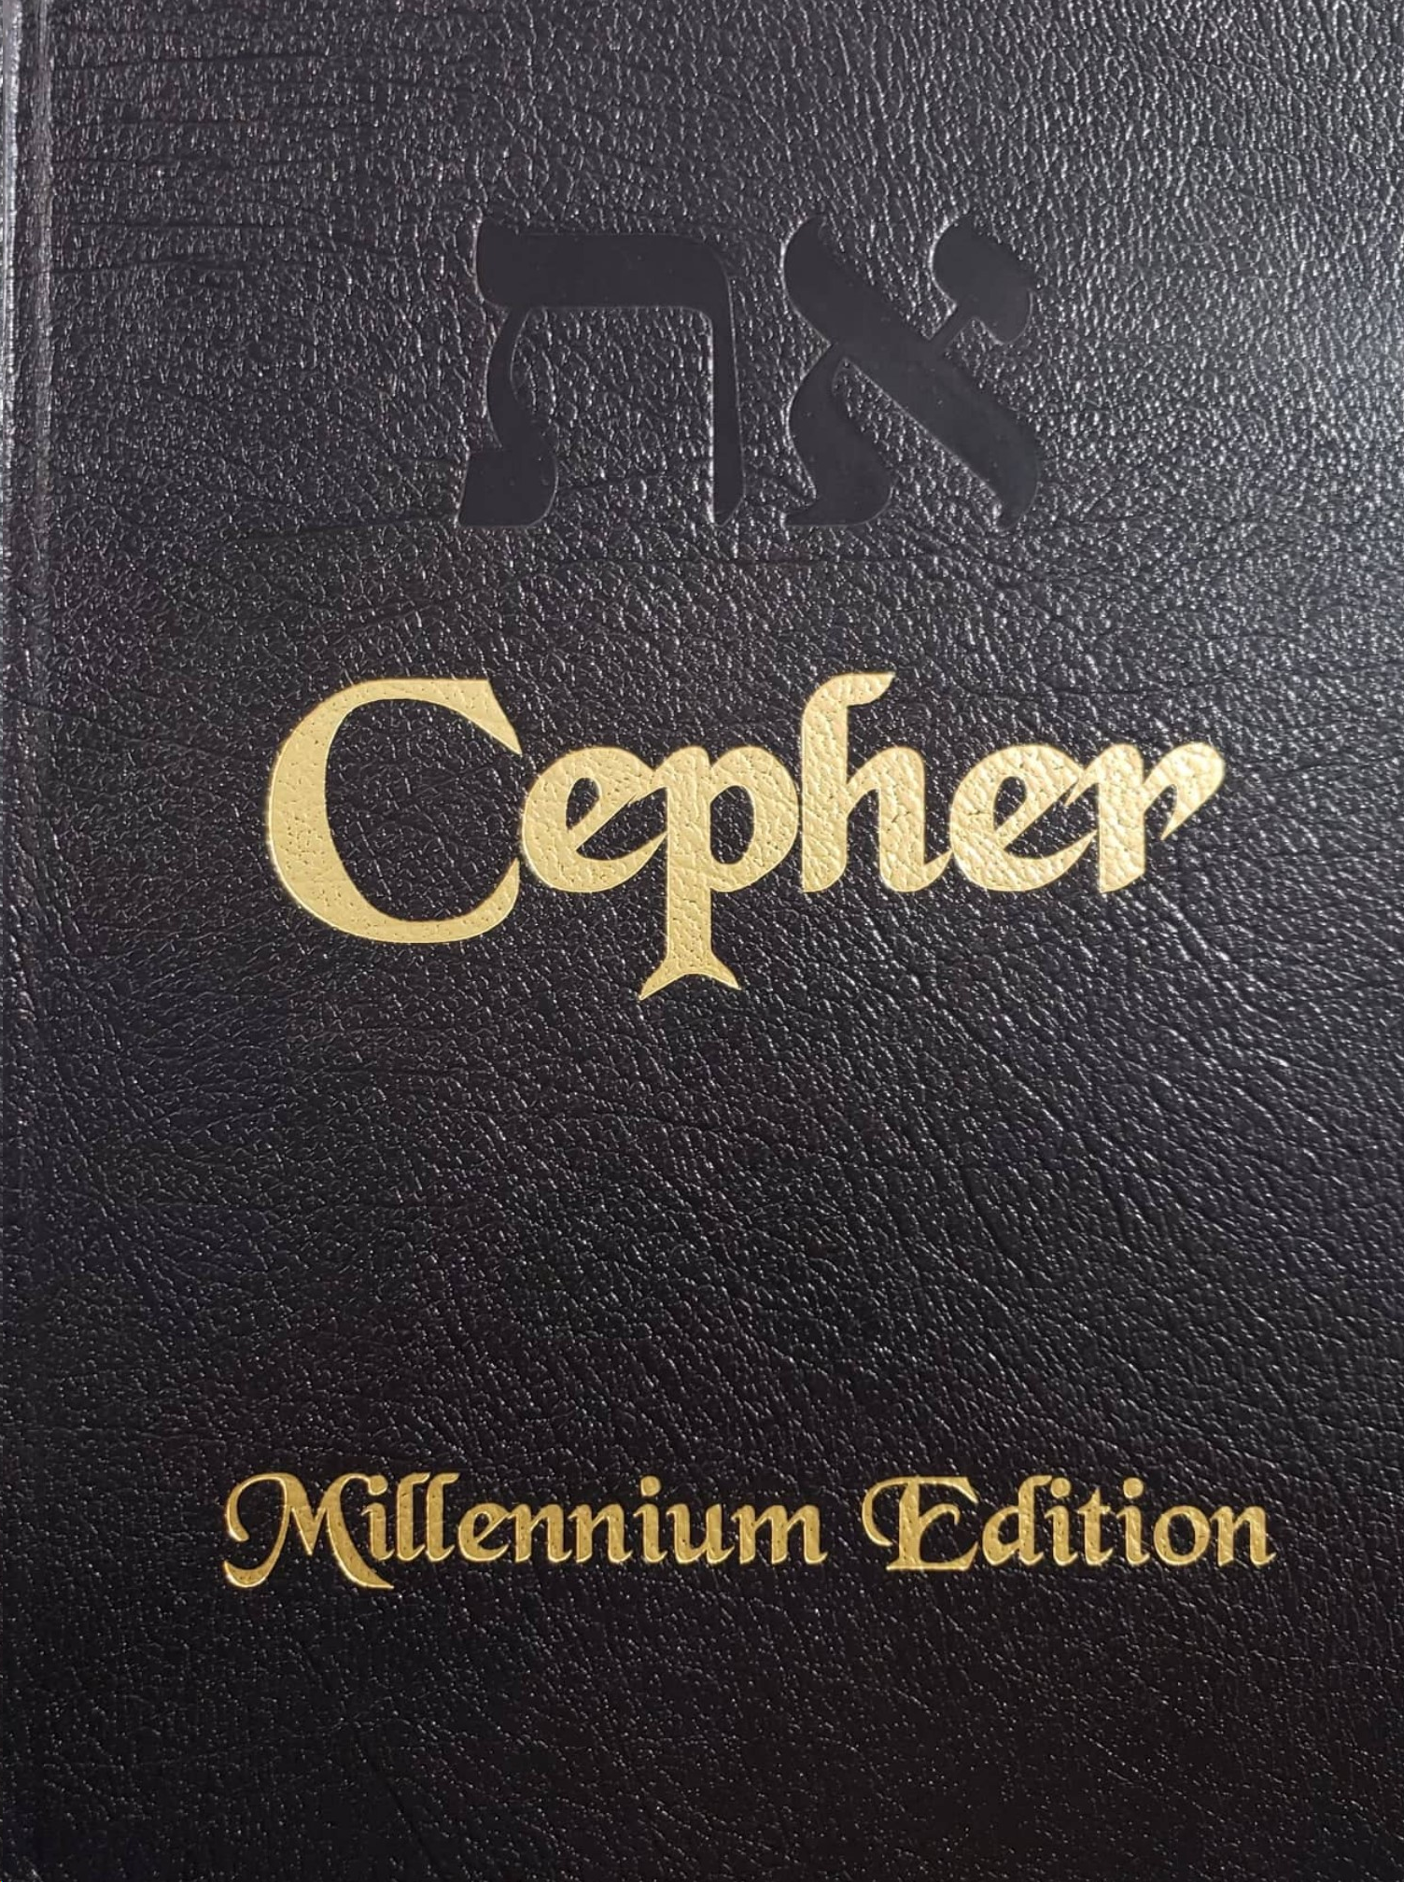
Cepher Distinguishment
How is the Cepher different from other settings of scripture?

Slide 4
Cepher Distinguishment
Let’s start with the first verse in most bibles:
Genesis 1:1 In the beginning God created the heavens and the earth.
This is the language of the NKJV; the ESV; the ASV; the NASB; the NIV; the NLT.
Genesis 1:1 In the beginning God created the heaven and the earth.
This is the language of the KJV:
But the name God does not appear there, either in the Hebrew (אֱלֹהִים), nor in the Greek (θεος). So why do they use the word God?

Slide 5
Cepher Distinguishment
Isaiah 65:11 :
“But you are those who forsake the Lord, Who forget My holy mountain,
Who prepare a table for Gad, And who furnish a drink offering for Meni.
NKJV. The NKJV tells us that Gad means a Troop or Fortune; a pagan deity;
and that Meni means a Number or Destiny; a pagan deity.
Gad is not pronounced gad like in add, but gawd, like in god. This is why the Jews use the spelling G_d – because they know the word is actually spelled Gad but spoken as God. Isaiah condemns those who prepare a table for G_d (Fortune or luck) and furnish a drink offering for Meni (Fate).
Gad and Meni are Fortune and Fate. It was this word the English translators elected to use to replace Elohiym in Hebrew, and Theos in Greek.

Slide 6
Cepher Distinguishment
In the beginning “good luck” created the heavens and the earth!
Isaiah 65:11:
KJV: But ye are they that forsake the Lord, that forget my holy mountain, that prepare a table for that troop, and that furnish the drink offering unto that number.
ESV: But you who forsake the Lord, who forget my holy mountain, who set a table for Fortune and fill cups of mixed wine for Destiny,
ASV: But ye that forsake Jehovah, that forget my holy mountain, that prepare a table for Fortune (footnote Gad), and that fill up mingled wine unto Destiny (footnote Meni);
NASB: But as for you who abandon the Lord, Who forget My holy mountain, Who set a table for Fortune (footnote Gad), And fill a jug of mixed wine for Destiny (footnote Meni)
NIV: But as for you who forsake the Lord and forget my holy mountain, who spread a table for Fortune and fill bowls of mixed wine for Destiny,
NLT: But because the rest of you have forsaken the Lord and have forgotten his Temple, and because you have prepared feasts to honor the god of Fate and have offered mixed wine to the god of Destiny,

Slide 7
Cepher Distinguishment
Exodus 3:15
And God said moreover unto Moses, Thus shalt thou say unto the children of Israel, the Lord God of your fathers, the God of Abraham, the God of Isaac, and the God of Jacob, hath sent me unto you: this is my name for ever, and this is my memorial unto all generations.
KJV
So, we have been taught that “the Lord God” is his name forever.
But a name is particular and is accurately set forth in the text.
In the Hebrew, it is:
יהוה

Slide 8
Cepher Distinguishment
Let’s see how the NLT deals with this:
Exodus 3:15
God also said to Moses, “Say this to the people of Israel: Yahweh,[a] the God of your ancestors—the God of Abraham, the God of Isaac, and the God of Jacob—has sent me to you. This is my eternal name, my name to remember for all generations.
3:15 Yahweh (also in 3:16) is a transliteration of the proper name YHWH that is sometimes rendered “Jehovah”; in this translation it is usually rendered “the Lord” (note the use of small capitals).
NLT
The NLT admits that this name is derived from (יהוה), but then use the pronunciation Yahweh. Where did they get that idea?

Slide 9
Cepher Distinguishment
Exodus 3:15
ESV: God also said to Moses, “Say this to the people of Israel: ‘The Lord, the God of your fathers, the God of Abraham, the God of Isaac, and the God of Jacob, has sent me to you.’ This is my name forever, and thus I am to be remembered throughout all generations.
NASB: God furthermore said to Moses, “This is what you shall say to the sons of Israel: ‘The Lord, the God of your fathers, the God of Abraham, the God of Isaac, and the God of Jacob, has sent me to you.’ This is My name forever, and this is the name for all generations to use to call upon Me.

Slide 10
Cepher Distinguishment
Exodus 3:15
NIV: God also said to Moses, “Say to the Israelites, ‘The Lord, the God of your fathers—the God of Abraham, the God of Isaac and the God of Jacob—has sent me to you.’ “This is my name forever, the name you shall call me from generation to generation.
NKJV: Moreover God said to Moses, “Thus you shall say to the children of Israel: ‘The Lord God of your fathers, the God of Abraham, the God of Isaac, and the God of Jacob, has sent me to you. This is My name forever, and this is My memorial to all generations.’

Slide 11
Cepher Distinguishment
Exodus 6:3
KJV: And I appeared unto Abraham, unto Isaac, and unto Jacob, by the name of God Almighty, but by my name Jehovah was I not known to them.
ASV: and I appeared unto Abraham, unto Isaac, and unto Jacob, as God Almighty; but by my name Jehovah I was not known to them.
ESV: I appeared to Abraham, to Isaac, and to Jacob, as God Almighty, but by my name the Lord I did not make myself known to them.

Slide 12
Cepher Distinguishment
Exodus 6:3
NIV: I appeared to Abraham, to Isaac and to Jacob as God Almighty, but by my name the Lord I did not make myself fully known to them.
NKJV: I appeared to Abraham, to Isaac, and to Jacob, as God Almighty, but by My name Lord I was not known to them.
NLT: I appeared to Abraham, to Isaac, and to Jacob as El-Shaddai—‘God Almighty’—but I did not reveal my name, Yahweh, to them.

Slide 13
Cepher Distinguishment
Exodus 6:3
וָאֵרָא אֶל־אַבְרָהָם אֶל־יִצְחָק וְאֶל־יַעֲקֹב בְּאֵל שַׁדָּי וּשְׁמִי יהוה לֹא נוֹדַעְתִּי לָהֶם׃
Va’erah El-Avraham El-Yitschaq v’El-Ya’aqov b’El Shaddai u’shemi Yahuah lo nivda’ati lahem.

Slide 14
Cepher Distinguishment
Isaiah 42:8
KJV: I am the Lord: that is my name: and my glory will I not give to another, neither my praise to graven images.
ASV: I am Jehovah, that is my name; and my glory will I not give to another, neither my praise unto graven images.
ESV: I am the Lord; that is my name; my glory I give to no other, nor my praise to carved idols.

Slide 15
Cepher Distinguishment
Isaiah 42:8
NIV: I am the Lord; that is my name! I will not yield my glory to another or my praise to idols.
NKJV: I am the Lord, that is My name; And My glory I will not give to another, Nor My praise to carved images.
NLT: I am the Lord; that is my name! I will not give my glory to anyone else, nor share my praise with carved idols.

Slide 16
Cepher Distinguishment
Who then is “the Lord”?
Baʻal (בַּעַל) H1167
This is a masculine noun meaning a master; hence, a husband, or (figuratively) owner (often used with another noun in modifications of this latter sense):— archer, babbler, bird, captain, chief man, confederate, have to do, dreamer, those to whom it is due, furious, those that are given to it, great, hairy, he that hath it, have, horseman, husband, lord, man, married, master, person.
From H1166 (בָּעַל) bâʻal, a primitive root meaning to be master.
The “Lord God” in Hebrew is Ba’al Gad – the master of fortune.

Slide 17
Cepher Distinguishment
Where are you in this?
11 And the children of Yashar’el did evil in the sight of Yahuah and served Ba`aliym: 12 And they forsook Yahuah Elohai of their fathers, which brought them out of the land of Mitsrayim, and followed other elohiym, of the elohiym of the people that were round about them, and bowed themselves unto them, and provoked Yahuah to anger. 13 And they forsook Yahuah and served Ba`al and Ashtaroth.
Shofetiym (Judges) 2:11-13

Slide 18
Cepher Distinguishment
Where are you in this?
16 And it shall be at that day, says Yahuah, that you shall call me Iyshiy; and shall call me no more Ba`aliy. 17 For I will take away the names of Ba`aliym out of her mouth, and they shall no more be remembered by their name.
Husha (Hosea) 2:16-17

Slide 19
Cepher Distinguishment
The name Yahusha
The book of Joshua in the Greek is called Ἰησοῖ υἱῷ Ναυη
καὶ ἐγένετο μετὰ τὴν τελευτὴν Μωυσῆ εἶπεν κύριος τῷ Ἰησοῖ υἱῷ Ναυη τῷ ὑπουργῷ Μωυσῆ λέγων
Ἰησοῦς (Iēsous) G2424 ee-ay-sooce'
Of Hebrew origin [H091]; Jesus, the name of our Lord and two (three) other Israelites: - Jesus.
H3091 isיהושע

Slide 20
Cepher Distinguishment
Joshua 1:1
וַיְהִי אַחֲרֵי מוֹת מֹשֶׁה עֶבֶד יהוה וַיֹּאמֶר יְהוָֹה אֶל־יהושע בִּן־נוּן מְשָׁרֵת מֹשֶׁה לֵאמֹר׃
V’yahi acheri miveth Moshe ebed Yahuah vayi’amar El-Yahusha ben-nun m’shareth Moshe l’amer.

Slide 21
Cepher Distinguishment
Joshua 1:1
יהושע
This name Yahusha (יהושע) appears in this form in the following verses: Ex 17:9-10,13-14; Ex 32:17; Ex 33:11; Nu 11:28; Nu 13:16; Nu 27:18,22; Nu 32:28; De 1:38; De 3:28; De 31:3,14,23; Jos 1:1,10,12,16; Jos 2:1,23-24; Jos 3:1,5-7,9-10; Jos 4:1,4-5,8-10,14-15,17,20; Jos 5:2-4,7,9,13-15; Jos 6:2,6,8,10,12,16,22,25-27; Jos 7:2-3,6-7,10,16,19-20,22-25; Jos 8:1,3,9-10,13,15-16,18,23,27-30,35; Jos 9:2-3,6,8,15,22,24,27; Jos 10:1,4,6-9,12,15,18,20-22,24-29,31,33-34,36,38,40-43; Jos 11:6-7,9-10,12-13,15-16,18,21,23; Jos 12:7; Jos 14:6,13; Jos 17:4,14-15,17; Jos 18:3,8-10; Jos 20:1; Jos 21:1; Jos 22:1,6-7; Jos 23:2; Jos 24:1-2,19,21-22,24-29,31; Jg 1:1; Jg 2:6-8,21,23; 1Sa 6:14,18; 1Ki 16:34; 2Ki 23:8; 1Ch 7:27; Hag 1:1,14; Hag 2:2,4; Zec 3:1,8-9; Zec 6:11

Slide 22
Cepher Distinguishment
Joshua 1:1
יְהוֹשׁוּעַ
The name that sacred name haters like to claim is the true pronunciation of the name of Joshua (יהושע) which is Yahoshua (יְהוֹשׁוּעַ) appears in this form in the following verses: De 3:21; Jg 2:7

Slide 23
Cepher Distinguishment
The name Yeshua
יֵשׁוּעַ
Yeshua (יֵשׁוּעַ) H3442; according to Strong’s , this name is used “for H3091 (יהושע)(Yahusha)” although they don’t say by whom; he will save; Jeshua, the name of ten Israelites, also of a place in Palestine:—Jeshua.
Now these are the children of the province that went up out of the captivity, of those which had been carried away, whom Nevukadne’tstsar the king of Babel had carried away unto Babel, and came again unto Yerushalayim and Yahudah, eve-ryone unto his city; 2 Which came with Zerubbavel: Yeshua, Nechemyahu, Serayahu, Re`elayah, Mordekai, Bilshan, Micpar, Bigvai, Rechum, Ba`anah. The number of the men of the people of Yashar’el:
Ezra v’Nechemyahu (Ezra) 2:1-2

Slide 24
Cepher Distinguishment
Joshua 1:1
יֵשׁוּעַ
The claim that Yeshua is the true name of the Mashiach is intellectually lazy and merely restates an improper and inaccurate colloquialism. Yeshua (יֵשׁוּעַ) in this form in the following verses: 1Ch 24:11; 2Ch 31:15; Ezr 2:2,6,36,40; Ezr 3:2,8-9; Ezr 4:3; Ezr 8:33; Ezr 10:18; Ne 3:19; Ne 7:7,11,39,43; Ne 8:7,17; Ne 9:4-5; Ne 10:9; Ne 11:26; Ne 12:1,7-8,10,24,26.
Strong’s tell us conclusively that the Greek name ̓ησοῦς (Iesous) is the Greek name of the Mashiach, and that the Hebrew name is H3901 – Yahusha (יהושע). You don’t have to take my word for it.

