Slide 1
Revelation Revisited – Part 2
The Principality
3rd Temple
Rapture (second Exodus)
Physical Jerusalem
“And he shall come to the astonishment of them that dwell on the earth.”
EZRA REVIY`IY (4 EZRA) 13:25-30

Slide 2
Referenced Books
All scriptural references are made from the Cepher unless otherwise stated.
New Testament
Old Testament
Apocrypha – were these part of Ezra’s Canon ? (70 hidden works)
4 Ezra 14:456-47 But keep the seventy last, that you may deliver them only to such as be wise among the people: For in them is the spring of understanding, the fountain of wisdom, and the stream of knowledge

Slide 3
As we begin !
Saints to partake in Tribulation but not Wrath
Context of the plagues of Egypt/Destroyer
WISDOM 18.9 For the righteous children of good men did sacrifice secretly, and with one consent made a holy law, that the saints should be like partakers of the same good and evil, the fathers now singing out the songs of praise.
Rom 5:9 Much more then, being now justified by his blood, we shall be saved from wrath through him.
The Man of Sin must be revealed before Wrath starts – we should expect to see him.. !
2Th 2:3 Let no man deceive you by any means: for that day shall not come, except there come a falling away first, and that man of sin be revealed, the son of perdition;

Slide 4
The Seven Churches – Some Notable Points..
Overcome
7 Assemblies
7 Archetypes of Believers
2000 years of tribulation – your own life
Final period at the end of the age
Ephesus
Smyrna
Pergamum
Thyatira
Sardis
Philadelphia
Laodicea
Rev 2:7, 2:11, 2:17 He that has an ear, let him hear את what the Ruach says unto the called out assemblies;
To him that overcomes will I give to eat of the tree of life, which is in the midst of the paradise of Elohiym
He that overcomes shall not be hurt of the second death.
To him that overcomes will I give to eat of the hidden manna, and will give him a white stone, and in the stone a new name written, which no man knows saving he that receives it.
All Assemblies
Smyrna
Rev 2:10 Fear none of those things which you shall suffer: behold, the devil shall cast some of you into prison, that ye may be tried; and ye shall have tribulation ten days: be faithful unto death, and I will give you a crown of life.
Thyatira
Rev 2:26 And he that overcomes, and guards my works unto the end, to him will I give power over the nations:
Rev 2:27 And he shall rule them with a rod of iron; as the vessels of a potter shall they be broken to shivers: even as I received of my Father.
Rev 2:28 And I will give him the morning star.
Not “in”
Philadelphia
Rev 3:10 Because you have guarded the word of my patience, I also will guard you from the hour of calamity, which shall come upon all the world, to try them that dwell upon the earth.

Slide 5
Which Jerusalem are we looking for and looking at ?
John
The New Heaven and the New Earth
Rev 21:1 AND I saw a renewed heaven and a renewed earth: for the first heaven and the first earth were passed away; and there was no more sea.
Rev 21:2 And I Yochanon saw the holy city, Renewed Yerushalayim, coming down from Elohiym out of heaven, prepared as a bride adorned for her man.
Rev 21:3 And I heard a great voice out of heaven saying, Behold, the Tabernacle of Elohiym is with men, and he will tabernacle with them, and they shall be his people, and Elohiym himself shall be with them, and be their Elohiym.
Baruk
On the Destruction of Jerusalem
AND Yahuah said unto me: This city shall be delivered up for a time; and the people shall be chastened during a time; and the world will not be given over to oblivion. Do you think that this is that city of which I said: On the palms of my hands have I graven you?
This building now built in your midst is not that which is revealed with me, that which was prepared beforehand here from the time when I took counsel to make Paradise, and showed it to A'dam before he sinned, but when he transgressed the commandment it was removed from him, as also Paradise. And after these things I showed it to my servant Avraham by night among the portions of the victims. And again also I showed it to Mosheh on Mount Ciynai when I showed to him the likeness of the Tabernacle and all its vessels. And now, behold, it is preserved with me, as also Paradise. Go, therefore, and do as I command you. BARUK SHENIY (2 BARUK) 4:1-6 את CEPHER

Slide 6
Yahusha’s Principate on Earth – in the current age of corruption
Two voices…
Baruk
THE last leader of that time will be left alive, when the multitude of his hosts will be put to the sword, and he will be bound, and they will take him up to Mount Tsiyon, and my Mashiach will convict him of all his impieties, and will gather and set before him all the works of his hosts.
And afterwards he will put him to death, and protect the rest of my people which shall be found in the place which I have chosen. And his principate will stand forever, until the world of corruption is at an end, and until the times aforesaid are fulfilled. This is your vision, and this is its interpretation. BARUK SHENIY (2 BARUK) 40:1-4 את CEPHER
Ezra
And whosoever is delivered from the foresaid evils shall see my wonders. For my Son Yahusha shall be revealed with those that be with him, and they that remain shall rejoice within four hundred years. After these years shall my Son Mashiach die, and all men that have life. And the world shall be turned into the old silence seven days, like as in the former judgments: so that no man shall remain. And after seven days the world, that yet awakens not, shall be raised up, and that shall die that is corrupt. And the earth shall restore those that are asleep in her, and so shall the dust those that dwell in silence, and the secret places shall deliver those souls that were committed unto them. EZRA REVIY`IY (4 EZRA) 7:27-32 את CIPHER
So how do we get here ?

Slide 7
Any other evidences
Earthly Rule before the perfection of New Heaven and New Earth ?
The Son of Man Is Given Dominion
Dan 7:13 I saw in the night visions, and, behold, one like the Son of Man came with the clouds of heaven, and came to the Ancient of Days, and they brought him near before him.
Dan 7:14 And there was given him dominion, and glory, and a Kingdom, that all people, nations, and languages, should serve him: his dominion is an everlasting dominion, which shall not pass away, and his Kingdom that which shall not be destroyed.
Daniel
Other Nations implies other leaders and other dominions
Isn’t there one language in heaven ?
Adam could speak to the animals, angels and Yah !
John
Rev 2:26 And he that overcomes, and guards my works unto the end, to him will I give power over the nations:
Rev 2:27 And he shall rule them with a rod of iron; as the vessels of a potter shall they be broken to shivers: even as I received of my Father.
Rev 2:28 And I will give him the morning star.
Rev 2:29 He that has an ear, let him hear את what the Ruach says unto the called out assemblies.

Slide 8
Any other evidences - Earthly Rule before the perfection of New Heaven and New Earth ?
Isaiah
Time-lock
Most planes are white in the distance like doves
Isa 60:8 Who are these that fly as a cloud, and as the doves to their windows?
Isa 60:9 Surely the isles shall wait for me, and the ships of Tarshiysh first, to bring your sons from far, their silver and their gold with them, unto the name of Yahuah Elohayka, and to the Holy One of Yashar’el, because he has glorified you.
Isa 60:10 And the sons of strangers shall build up your walls, and their kings shall minister unto you: for in my wrath I smote you, but in my favor have I had mercy on you.
Isa 60:11 Therefore your gates shall be open continually; they shall not be shut day nor night; that men may bring unto you the forces of the other nations, and that their kings may be brought.
Isa 60:12 For the nation and kingdom that will not serve you shall perish; yea, those nations shall be utterly wasted.
Isa 60:13 The glory of Lebanon shall come unto you, the fir tree, the pine tree, and the box together, to beautify the place of my sanctuary; and I will make the place of my feet glorious.
Isa 60:14 The sons also of them that afflicted you shall come bending unto you; and all they that despised you shall bow themselves down at the soles of your feet; and they shall call you, The city of Yahuah, The Tsiyon of the Holy One of Yashar’el.
Isa 60:15 Whereas you have been forsaken and hated, so that no man went through you, I will make you an eternal excellency, a joy of many generations.
Isa 60:16 You shall also suck the milk of the other nations, and shall suck the breast of kings: and you shall know that I Yahuah am your Savior and your Redeemer, the Mighty One of Ya`aqov.
Isa 60:17 For brass I will bring gold, and for iron I will bring silver, and for wood brass, and for stones iron: I will also make your officers peace, and your exactors righteousness.
Isa 60:18 Violence shall no more be heard in your land, wasting nor destruction within your borders; but you shall call your walls Yeshu`ah, and your gates Praise.
Isa 60:19 The sun shall be no more your light by day; neither for brightness shall the moon give light unto you: but Yahuah shall be unto you an everlasting light, and your Elohiym your glory.

Slide 9
Any other evidences - Earthly Rule before the perfection of New Heaven and New Earth ?
Must be on Earth – for in the heavenlies we are not given to marriage..
Gender specificity suggests war – a long set of violent wars (not a bioweapon)
Isaiah
Isa 4:1 AND in that day seven women shall take hold of one man, saying, We will eat our own bread, and wear our own apparel: only let us be called by your name, to take away our reproach.
The Branch of the Lord Glorified
Isa 4:2 In that day shall the branch of Yahuah be beautiful and glorious, and the fruit of the earth shall be excellent and comely for them that are escaped of Yashar’el.
Isa 4:3 And it shall come to pass, that he that is left in Tsiyon, and he that remains in Yerushalayim, shall be called holy, even everyone that is written among the living in Yerushalayim:
Isa 4:4 When Adonai shall have washed away את the filth of the daughters of Tsiyon, and shall have purged the blood of Yerushalayim from the midst thereof by the Ruach Mishpat, and by the Ruach Ba’ar.
Isa 4:5 And Yahuah will create upon every dwelling place of Mount Tsiyon, and upon her assemblies, a cloud and smoke by day, and the shining of a flaming fire by night: for upon all the glory shall be a defence.
Isa 4:6 And there shall be a tabernacle for a shadow in the daytime from the heat, and for a place of refuge, and for a covert from storm and from rain.

Slide 10
The Fourth Kingdom
Rome
Dan 2:40 And the fourth kingdom shall be strong as iron: forasmuch as iron breaks in pieces and subdues all things: and as iron that breaks all these, shall it break in pieces and bruise.
Dan 2:41 And whereas you saw the feet and toes, part of potters' clay, and part of iron, the kingdom shall be divided; but there shall be in it of the strength of the iron, forasmuch as you saw the iron mixed with miry clay.
Dan 2:42 And as the toes of the feet were part of iron, and part of clay, so the kingdom shall be partly strong, and partly broken.
Dan 2:43 And whereas you saw iron mixed with miry clay, they shall mingle themselves with the seed of men: but they shall not cleave one to another, even as iron is not mixed with clay.
Baruk
And after these things a fourth kingdom will arise, whose power will be harsh and evil far beyond those which were before it, and it will rule many times as the forests on the plain, and it will hold fast for times, and will exalt itself more than the cedars of Lebanon. And by it the Truth will be hidden, and all those who are polluted with iniquity will flee to it, as evil beasts flee and creep into the forest.
And it will come to pass when the time of its consummation that it should fall has approached, then the principate of my Mashiach will be revealed, which is like the fountain and the vine, and when it is revealed it will root out the multitude of its host. And as touching that which you have seen, the lofty cedar, which was left of that forest, and the fact, that the vine spoke those words with it which you did hear, this is the word. BARUK SHENIY (2 BARUK) 39:5-8 את CEPHER

Slide 11
Yahusha’s Arrival - Gospels
Day of the Lord
Sixth Seal description
Event before Wrath
The Coming of the Son of Man
Mat 24:29 Immediately after the tribulation of those days shall the sun be darkened, and the moon shall not give her light,
and the stars shall fall from heaven, and the powers of the heavens shall be shaken:
Mat 24:30 And then shall appear the sign of the Son of A’dam in heaven: and then shall all the tribes of the earth mourn, and they shall see the Son of A’dam coming in the clouds of heaven with power and great glory.
Mat 24:31 And he shall send his angels with a great sound of a shofar, and they shall gather together his elect from the four winds, from one end of heaven to the other.
The Coming of the Son of Man
Mar 13:24 But in those days, after that tribulation, the sun shall be darkened, and the moon shall not give her light,
Mar 13:25 And the stars of heaven shall fall, and the powers that are in heaven shall be shaken.
Mar 13:26 And then shall they see the Son of A’dam coming in the clouds with great power and glory.
Mar 13:27 And then shall he send his angels, and shall gather together his elect from the four winds, from the uttermost part of the earth to the uttermost part of heaven.
The Coming of the Son of Man
Luk 21:25 And there shall be signs in the sun, and in the moon, and in the stars; and upon the earth distress of nations, with perplexity; the sea and the waves roaring;
Luk 21:26 Men's hearts failing them for fear, and for looking after those things which are coming on the earth: for the powers of heaven shall be shaken.
Luk 21:27 And then shall they see the Son of A’dam coming in a cloud with power and great glory.
Luk 21:28 And when these things begin to come to pass, then look up, and lift up your heads; for your redemption draws nigh.

Slide 12
Set Aside People
Isa 11:11-16 And it shall come to pass in that day, that Adonai shall set his hand again the second time to recover the remnant of his people.
No One Knows That Day and Hour
Mat 24:36 But of that day and hour knows no man, no, not the angels of heaven, but my Father only.
Mat 24:37 But as the days of Noach were, so shall also the coming of the Son of A’dam be.
Mat 24:38 For as in the days that were before the flood they were eating and drinking, marrying and giving in marriage, until the day that Noach entered into the ark,
Mat 24:39 And knew not until the flood came, and took them all away; so shall also the coming of the Son of A’dam be.
Mat 24:40 Then shall two be in the field; one is received and the other forsaken.
Mat 24:41 Two are grinding at the millhouse; one is received and the other forsaken.
Baruk
A Chosen place of Yahuah for his people – a place of Safety
THE last leader of that time will be left alive, when the multitude of his hosts will be put to the sword, and he will be bound, and they will take him up to Mount Tsiyon, and my Mashiach will convict him of all his impieties, and will gather and set before him all the works of his hosts.
And afterwards he will put him to death, and protect the rest of my people which shall be found in the place which I have chosen.
And his principate will stand forever, until the world of corruption is at an end, and until the times aforesaid are fulfilled. This is your vision, and this is its interpretation. BARUK SHENIY (2 BARUK) 40:1-4 את CEPHER
AND the holy land shall have mercy on its own, and it shall protect its inhabiters at that time. This is the vision which you have seen, and this is the interpretation. For I have come to tell you these things because your prayer has been heard with El Elyon. BARUK SHENIY (2 BARUK) 71:1-3 את CEPHER

Slide 13
Yahusha’s Arrival - Ezra’s Vision
Ezra
(4 EZRA) 13:1-6 AND it came to pass after seven days, I dreamed a dream by night: And, lo, there arose a wind from the sea, that it moved all the waves thereof.
And I beheld, and, lo, that a man waxed strong with the thousands of heaven: and when he turned his countenance to look, all the things trembled that were seen under him. And whensoever the voice went out of his mouth, all they burned that heard his voice, like as the earth fails when it feels the fire.
And after this I beheld, and, lo, there was gathered together a multitude of men, out of number, from the four winds of the heaven, to subdue the man that came out of the sea. But I beheld, and, lo, he had graved himself a great mountain, and flew up upon it.
But I would have seen the region or place whereout the hill was graven, and I could not. And after this I beheld, and, lo, all they which were gathered together to subdue him were sore afraid, and yet dared fight. And, lo, as he saw the violence of the multitude that came, he neither lifted up his hand, nor held sword, nor any instrument of war: But only I saw that he sent out of his mouth as it had been a blast of fire, and out of his lips a flaming breath, and out of his tongue he cast out sparks and tempests. And they were all mixed together; the blast of fire, the flaming breath, and the great tempest; and fell with violence upon the multitude which was prepared to fight, and burned them up everyone, so that upon a sudden of an innumerable multitude nothing was to be perceived, but only dust and smell of smoke: when I saw this I was afraid. Afterward saw I the same man come down from the mountain, and call unto him another peaceable multitude. EZRA REVIY`IY (4 EZRA) 13:7-12 את CEPHER
Now understand I the things that are laid up in the latter days, which shall happen unto them, and to those that are left behind.
EZRA REVIY`IY (4 EZRA) 13:18 את CEPHER
ת CEPHER

Slide 14
Yahusha’s Arrival – Interpretation
Ezra
Whereas you have spoken of them that are left behind, this is the interpretation: (4 EZRA) 13:22-24
He that shall endure the peril in that time has kept himself: they that be fallen into danger are such as have works, and faith toward El Shaddai. Know this therefore, that they which be left behind are more blessed than they that be dead.
This is the meaning of the vision: Whereas you saw a man coming up from the midst of the sea: The same is he whom El Elyon has kept a great season, which by his own self shall deliver his creature: and he shall order them that are left behind. And whereas you saw, that out of his mouth there came as a blast of wind, and fire, and storm; And that he held neither sword, nor any instrument of war, but that the rushing in of him destroyed the whole multitude that came to subdue him; this is the interpretation: Behold, the days come, when El Elyon will begin to deliver them that are upon the earth. And he shall come to the astonishment of them that dwell on the earth.
And one shall undertake to fight against another, one city against another, one place against another, one people against another, and one realm against another. And the time shall be when these things shall come to pass, and the signs shall happen which I showed you before, and then shall my Son be declared, whom you saw as a man ascending. And when all the people hear his voice, every man shall in their own land leave the battle they have one against another. And an innumerable multitude shall be gathered together, as you saw them, willing to come, and to overcome him by fighting. But he shall stand upon the top of Mount Tsiyon. And Tsiyon shall come, and shall be showed to all men, being prepared and built, like as you saw the hill graven without hands. And this my Son shall rebuke the wicked inventions of those nations, which for their wicked life are fallen into the tempest; And shall lay before them their evil thoughts, and the torments wherewith they shall begin to be tormented, which are like unto a flame: and he shall destroy them without labor by the Torah which is like unto me. (4 EZRA) 13:25-38 את CEPHER
Now when he destroys the multitude of the nations that are gathered together, he shall defend his people that remain. And then shall he show them great wonders. EZRA REVIY`IY (4 EZRA) 13:49-50 את CEPHER

Slide 15
Transition into Eternity
Ezra
End of the Current World
After these years shall my Son Mashiach die, and all men that have life. And the world shall be turned into the old silence seven days, like as in the former judgments: so that no man shall remain. And after seven days the world, that yet awakens not, shall be raised up, and that shall die that is corrupt. And the earth shall restore those that are asleep in her, and so shall the dust those that dwell in silence, and the secret places shall deliver those souls that were committed unto them. (4 EZRA) 7:27-32
Seat of Judgement
And El Elyon shall appear upon the seat of judgment, and misery shall pass away, and the longsuffering shall have an end: But judgment only shall remain, truth shall stand, and faith shall wax strong: And the work shall follow, and the reward shall be showed, and the good deeds shall be of force, and wicked deeds shall bear no rule. Then the pit of torment shall appear, and opposite it shall be the place of rest; and the furnace of She’ol shall be disclosed, and opposite it the paradise of delight. Then El Elyon will say to the nations that have been raised from the dead: Look now, and understand whom ye have denied, whom ye have not served, whose commandments ye have despised! Look on this side and on that; here are delight and rest, and there are fire and torments! Thus, he will speak to them on the day of judgment. (4 EZRA) 7:33-38
A day that has no sun or moon or stars, or cloud or thunder or lightning or wind or water or air, or darkness or evening or morning, or summer or spring or heat or winter or frost or cold or hail or rain or dew, or noon or night, or dawn or shining or brightness or light, but only the splendor of the glory of El Elyon, by which all shall see what has been determined for them. For it will last for about a week of years. This is my judgment and its prescribed order; and to you alone have I shown these things. (4 EZRA) 7:39-44 א
Ezra
The New Heaven and the New Earth
Rev 21:1 AND I saw a renewed heaven and a renewed earth: for the first heaven and the first earth were passed away; and there was no more sea.
John

Slide 16
So where are we ?

Slide 17
Wars still to happen – could these wars be leading to Armageddon ?
Scripture
When
Event (Abridged)
Revelation 4th Seal
In season
Rev 6:8 And I looked, and behold a pale horse: and his name that sat on him was Death, and Hell followed with him. And power was given unto them over the fourth part of the earth, to kill with sword, and with hunger, and with death, and with the beasts of the earth. - Lion, Bear, Leopard, Diverse beast – Daniel 7
Revelation Mystery Babylon
Future - Revelation
Rev 18:2 And he cried mightily with a strong voice, saying, Babylon the great is fallen, is fallen, and is become the habitation of devils, and the hold of every foul spirit, and a cage of every unclean and hateful bird.
Rev 18:24 And in her was found the blood of prophets, and of saints, and of all that were slain upon the earth.
Ezekial 38
Gog/Magog
(1000 years) !
Ez 38:8 After many days in the latter years
Rev 20:7 And when the thousand years are expired, Satan shall be loosed out of his prison,
Rev 20:8 And shall go out to deceive the nations which are in the four quarters of the earth, Gog and Magog, to gather them together to battle: the number of whom is as the sand of the sea.
Joel army
Day of the Lord
Future - Revelation
Joe 2:4 The appearance of them is as the appearance of horses; and as horsemen, so shall they run.
Joe 2:5 Like the noise of chariots on the tops of mountains shall they leap, like the noise of a flame of fire that devours the stubble, as a strong people set in battle array.
Armageddon
Future - Revelation
Rev 19:11 And I saw heaven opened, and behold a white horse; and he that sat upon him was called Faithful and True, and in righteousness he judges and makes war.
Revelation Euphrates
Future - Revelation
Rev 9:14 Saying to the sixth angel which had the trumpet, Loose the four angels which are bound in the great river Euphrates. Rev 9:15 And the four angels were loosed, which were prepared for an hour, and a day, and a month, and a year, for to slay the third part of men.
Rev 9:16 And the number of the army of the horsemen were two hundred thousand thousand: and I heard the number of them.

Slide 18
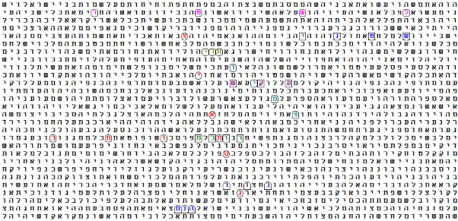
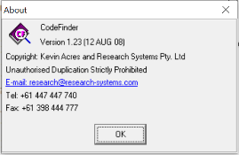
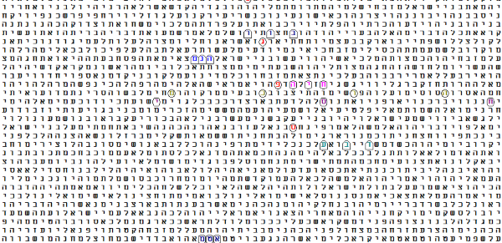
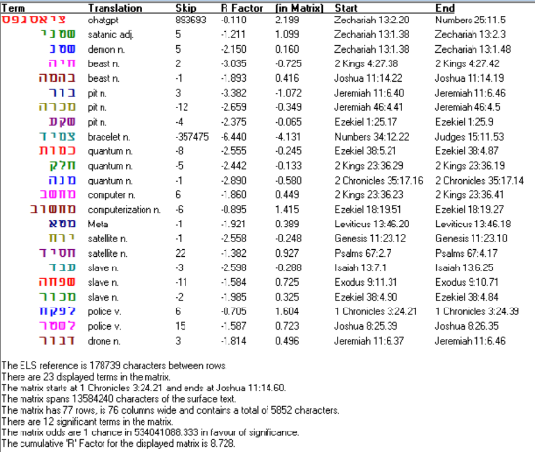
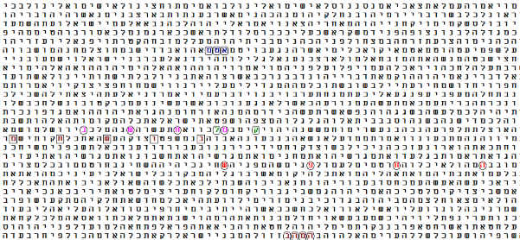
The Beast System… (Code search of the Tanach)
Search term “ChatGPT”
Police
Satellite
Satanic
Pit
ChatGPT
1 chance in 534,041,088
1 chance in 534 Million
Quantum
Bracelet
Slave
Pit
Drone
Quantum
Beast
Pit
Satellite
Slave
Meta
Computer
Quantum
Computerisation
Slave
Beast

Slide 19
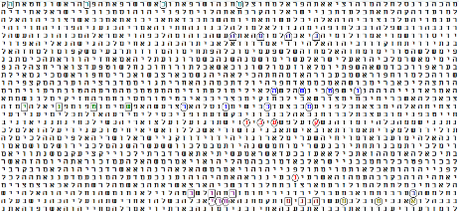
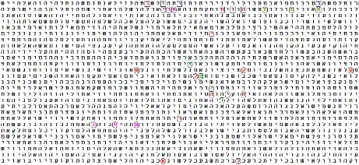
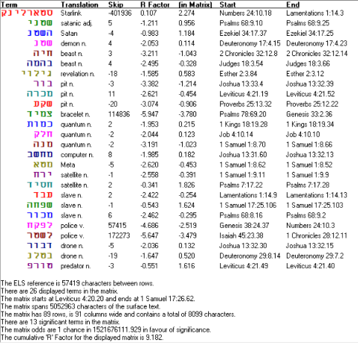
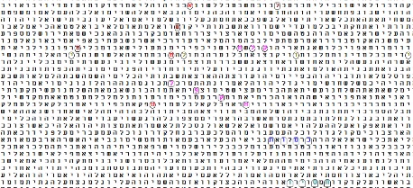
The Beast System… (Code search of the Tanach)
Search term “Starlink”
Predator
Pit
Beast
Slave
Satan
Satanic
1 chance in 1,521,676,111
1 chance in 1.5 Billion
Slave
Pit
Drone
Computer
Satellite
Quantum
Meta
Bracelet
Pit
Beast
Demon
Starlink
Police
Revelation
Police
Quantum
Satellite
Drone

