Slide 2
The Works of His Hands
The Secular world ignores these events as just scientific phenomena, they are asleep, looking at the distractions of this world, we are not to be caught out..!..
Isa 5:12 And the harp, and the viol, the tabret, and pipe, and wine, are in their feasts: but they regard not את the work of Yahuah, neither consider the operation of his hands.
Yahuah – Speaks through the Sun and the moon.. Why? – he knew that Satan would change the dates and the times (how many calendars do we have?), but Yah controls the heavens!
Dan 7:25 And he shall speak great words against El Elyon, and shall wear out the qodeshiym of El Elyon, and think to change times and law`s: and they shall be given into his hand until a period of time and times and the dividing of time.
What exactly did Yahuah say ?
Gen 1:14 And Elohiym said, Let there be lights in the expanse of the heavens to divide the day from the night; and let them be for signs, and for appointed feasts, and for days, and years:
H225 Oth - Mark, Omen, Flag, Miracle, token
H4150 mo-ade - an appointment, an assembly, a signal (as appointed beforehand)

Slide 3
Definitions.
What is the Spiritual Significance ?
What is it ?
Previous Events
A lunar eclipse occurs when the Sun, Earth, and Moon align so that the Moon passes into Earth’s shadow
Lunar eclipse is considered a bad sign for the Jewish nation*
Lunar Eclipse
Solar eclipse is a bad omen for the entire world*
1492 (05) Inquisition, Expel Jews from Spain
1918 (06) Spanish Flu
1945 (07) End of WW2
Solar Eclipse
A solar eclipse is a phenomenon that occurs when the Moon passes between the Sun and Earth and casts a shadow over Earth
A solar equinox is a moment in time when the Sun moves along the Earth's equator, rather than north or south of the equator.
12-hour day and 12-hour night - balance of light & dark (twice year)
Pagan witchcraft festivals of Ostara and Mabon
Equinox
Shooting Star
Shooting Star: A piece of rock from space that produces a bright light as it travels through the earth's atmosphere
An Arrival of somebody
(Abraham) (Yahusha)
Jasher 8:2 Abraham
Matthew2:9-10 Yahusha
Meteor, Asteroid,
Sodom & Gom Gen 19:24–25
Hail Rev 8:7
Hail Josh 10:11
Meteor: as above but reaches surface of a planet or moon
Destruction
https://dictionary.cambridge.org/dictionary/english/shooting-star
* https://www.chabad.org/library/article_cdo/aid/1394441/jewish/A-Blessing-for-a-Lunar-or-Solar-Eclipse.htm

Slide 4
Birth of Abraham
1 And it was in the night that Abram was born, that all the servants of Terah, and all the wise men of Nimrod, and his conjurors came and ate and drank in the house of Terah, and they rejoiced with him on that night.
2 And when all the wise men and conjurors went out from the house of Terah, they lifted up their eyes toward heaven that night to look at the stars, and they saw, and behold one very large star came from the east and ran in the heavens, and he swallowed up the four stars from the four sides of the heavens.
3 And all the wise men of the king and his conjurors were astonished at the sight, and the sages understood this matter, and they knew its import.
4 And they said to each other, This only betokens the child that has been born to Terah this night, who will grow up and be fruitful, and multiply, and possess all the earth, he and his children for ever, and he and his seed will slay great kings, and inherit their lands.
5 And the wise men and conjurors went home that night, and in the morning all these wise men and conjurors rose up early, and assembled in an appointed house.
6 And they spoke and said to each other, Behold the sight that we saw last night is hidden from the king, it has not been made known to him.
7 And should this thing get known to the king in the latter days, he will say to us, Why have you concealed this matter from me, and then we shall all suffer death; therefore, now let us go and tell the king the sight which we saw, and the interpretation thereof, and we shall then remain clear.

Slide 5
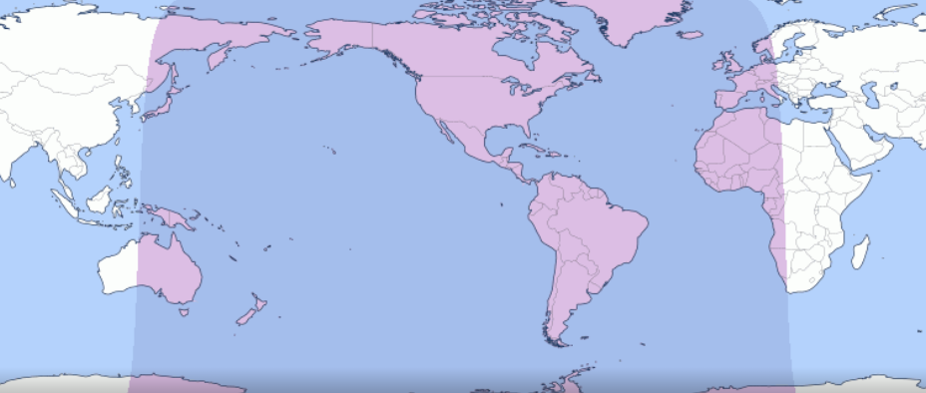
Short-term View
MFAW 40 day warning is this weekend
Equinox
Interim Weekend
Solar Eclipse
Lunar Eclipse
Tue | Wed | Thu
19 | 20 | 21
Fri | Sat | Sun | Mon
22 | 23 | 24 | 25
Fri | Sat | Sun | Mon
29 | 30 | 31 | 1
Fri | Sat | Sun | Mon
5 | 6 | 7 | 8
10 Days
Rev 2:10 Fear none of those things which you shall suffer: behold, the devil shall cast some of you into prison, that ye may be tried; and ye shall have tribulation ten days: be faithful unto death, and I will give you a crown of life.
https://www.timeanddate.com/eclipse/solar/2024-april-8

